Slide 1

Mini Project Project Review
on
Gesture Based volume control using Machine Learning
Algorithm
Presented by
M.Adithya(23CSE3003)
T.Rithwik(23CSE3007)
K.Nandan(23CSE3016)
G.Manoj(23CSE3014)
Under the guidance of

Slide 2
Contents:
  Literature survey
  Problem identification
  Objectives
  Abstract
  software requirements
  existing and proposed system
  block diagram
  references

Slide 3
Literature Survey
S.no | Authors | Title | year | Method used | Drawbacks
1 | Mrs.Aileen Emelda V, Shivani, Sanskruthi S | Hand gestures volume control using machine learning | 2023 | KNN,Mediapipe, open-CV etc. | less accuracy and Technical challenges
2 | Martendra Pratap Singh,Arzoo Poswal,Eshu Yadav | Volume control using Gestures | 2022 | Open-CV,Numpy Module,Mediapipe | Less reailable due to background disturbences

Slide 4
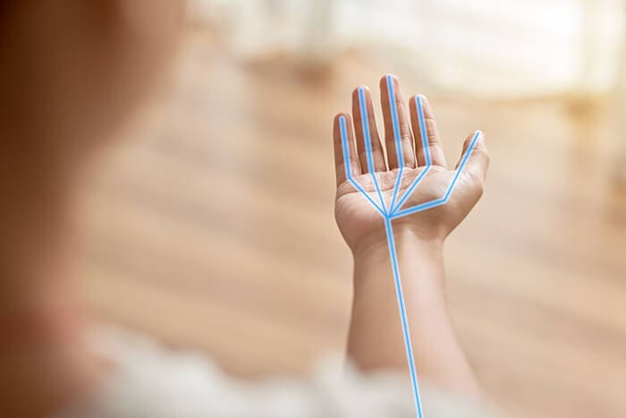


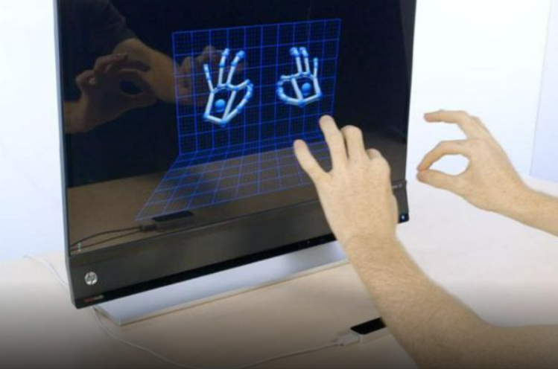
      PROBLEM IDENTIFICATION:
Traditional control limitations
Growing interest in gesture recognition
Need for Enhanced User Experience
Machine Learning Integration

Slide 5
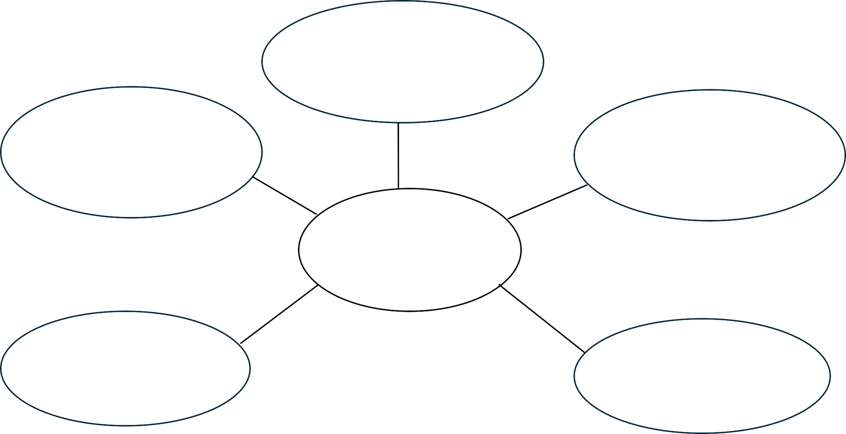
      OBJECTIVES:
Development of Gesture Recognition
Enhancement of
User Interaction
Implementation of Machine Learning Algorithms
Objectives
User-Friendly
Volume Control
Creation of a Diverse Gesture Dataset

Slide 6

      ABSTRACT:
      With real-time gesture recognition, a user can operate a computer by making a specific gesture in front of a Computer's camera. With the help of OpenCV module, we will create a hand gesture. Without the use of a key board or mouse, the system will be controlled by hand gestures. The main purpose of this project is to implement a gesture- based volume control using machine learning algorithm. In which it doesn't require any special markers, and it can be used in real-life on the basic PCs with inexpensive cameras.

Slide 7
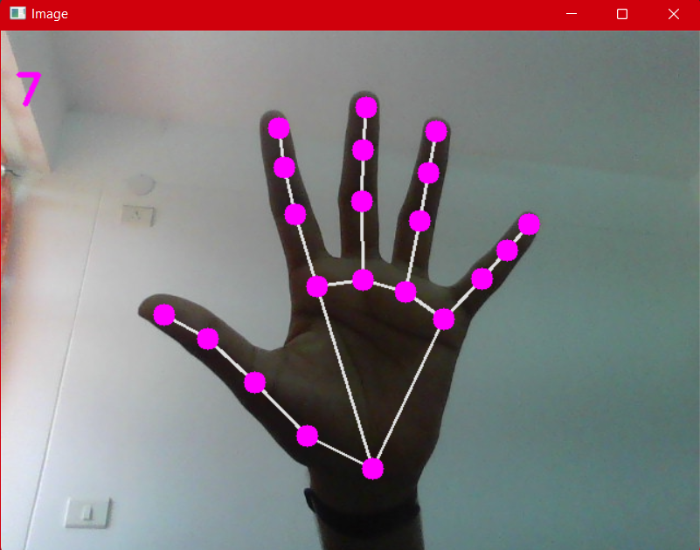
Software requirements:
  pycharm software
  open-CV Python
  mediapipe
  pyautoGUI packages

Slide 8
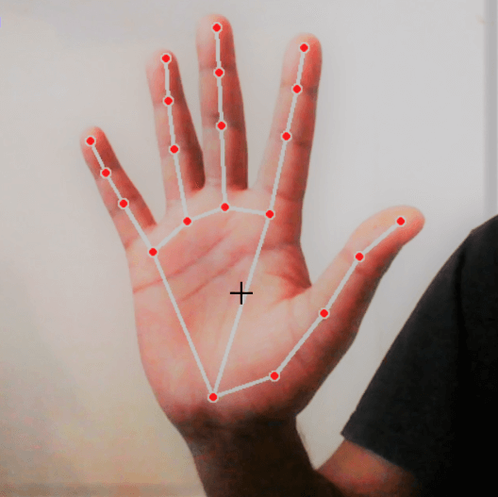
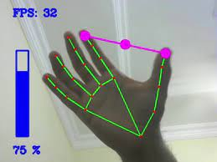
EXISTING SYSTEM
PROPOSED SYSTEM
Modules and libraries used:
  Capture and volume control module
  Hand detection module
  Gesture recognition module
  4. Open CV and mediapipe,Numphy etc.
Modules and libraries used:
  Capture and volume control module
  Hand Gesture recognition module
  3. Open CV and mediapipe
  4. pyautoGUI library

Slide 9




      BLOCK DIAGRAM:
Hand image
Hand Detection
Preprocessing
Feature Extraction
Recognition
Gesture Dictionary
Execution
Command

Slide 10
      REFERENCES:
      R.ALAMI ''A Methodological approach relating the classification
      of gesture to identification of human intent in the context of human-robot interaction", 371-377 2005
      PERALES "Hand tracking and gesture recognition for human- computer interaction",2005
      G.R.S. Murthy, R.S. Jadon. "A Review of vision based Hand Gestures Recognition," International Journal of Information Technology and Knowledge Management, vol.2(2),pp.405410, 2009.
      R.Liang and M. Ouhyoung. A Real-time continuous Gesture Recognition System for Sign Language. Proc. FG, 1998

Slide 11

THANK YOU

